Slide 1
Common Mechanisms

Slide 2
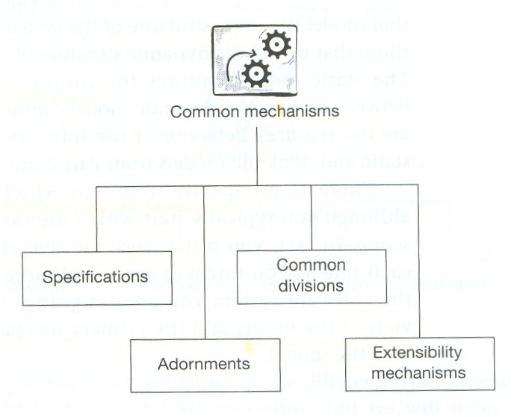
UML Common Mechanisms
UML has four common mechanisms that are applied consistently, in different contexts, throughout UML [Fig. 1.9, Arlow 2005]

Slide 3
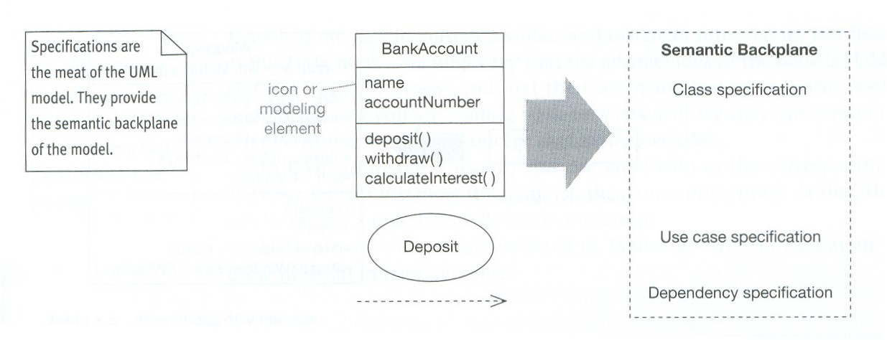
UML Common Mechanisms: Specifications
Specifications are textual descriptions of the semantics of UML elements. Example, Fig. 1.10 [Arlow & Neustadt, 2005]

Slide 4
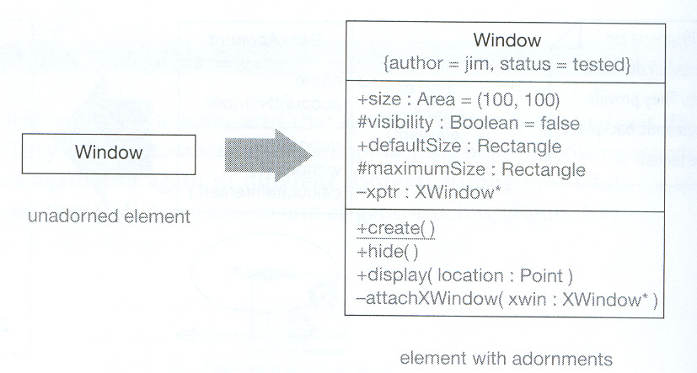
UML Common Mechanisms: Adornments
Adornments allow showing more information on UML elements. Example, Fig. 1.11 [Arlow & Neustadt, 2005]

Slide 5
UML Common Mechanisms: Common Divisions
Common divisions are ways of thinking about the world (for modeling purposes)
Common divisions in UML are of two types:
  Classifiers and instances [see Table 1.2 in the book]
  Interface and implementation

Slide 6
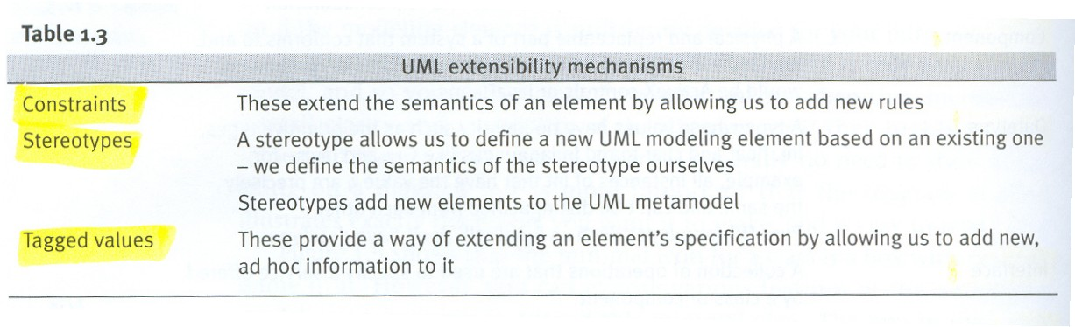
UML Common Mechanisms: Extensibility
There are three types of mechanisms that provide support for
UML extensibility, Table 1.3 [Arlow & Neustadt, 2005]

Slide 7
Architecture.
The system architecture is “the organizational structure of the system, including its decomposition into parts, their connectivity, interaction, mechanisms and the guiding principles that inform the design of a system.” [Rumbaugh 1998]
There is a typical “4+1 views” architecture of a system defined by UML:
  Logical view, captures the vocabulary of the problem domain using classes and objects
  Process view, depicts the threads and processes of the system as active classes
  Implementation view, shows the physical code base of the system in terms of components
  Deployment view, models the physical deployment of components onto computational nodes
  Use case view, captures the requirements of the system using a set of use cases. This is the view “+1” to which all other views connect.

Slide 8
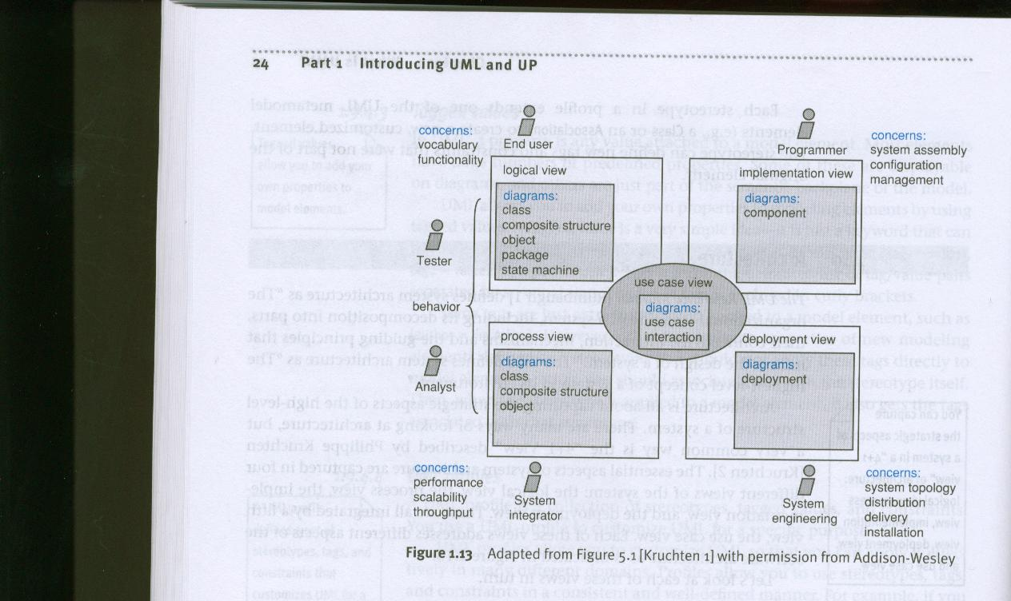
.Architecture
The “4 +1 views” architecture, Fig. 1.13 [Arlow & Neustadt 2005]

